Slide 1
Epileptic Seizure Recognition

Slide 2
Contents
Data Exploration
Cleaning and Sampling
Data Exploration Insights
ML Techniques

Slide 3
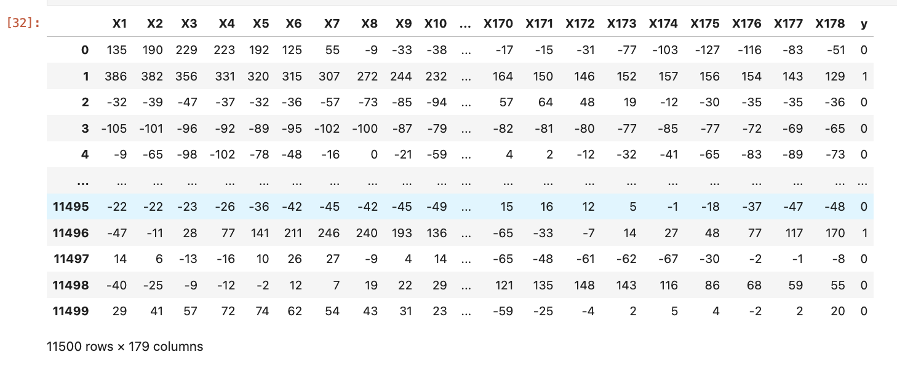
Initial Data Exploration
The dataset is composed of 11,500 samples of labeled EEG signal data (Figure 1)
Each sample consists of 179 time-series EEG signal readings for 1 second timeframe and 1 unused column (to be dropped).
Although the samples have 5 possible labels, for this project we are only considering 1=Seizure Activity, 0=Non-Seizure Activity.
There are 2,300 Seizure (1-label) records and 9,200 Non-Seizure (0-label) records.
Figure 1: The dataset with one unused column (Unnamed) dropped, showcasing the 11,500 samples at the 179 different time points as well as the binary target variable y.

Slide 4
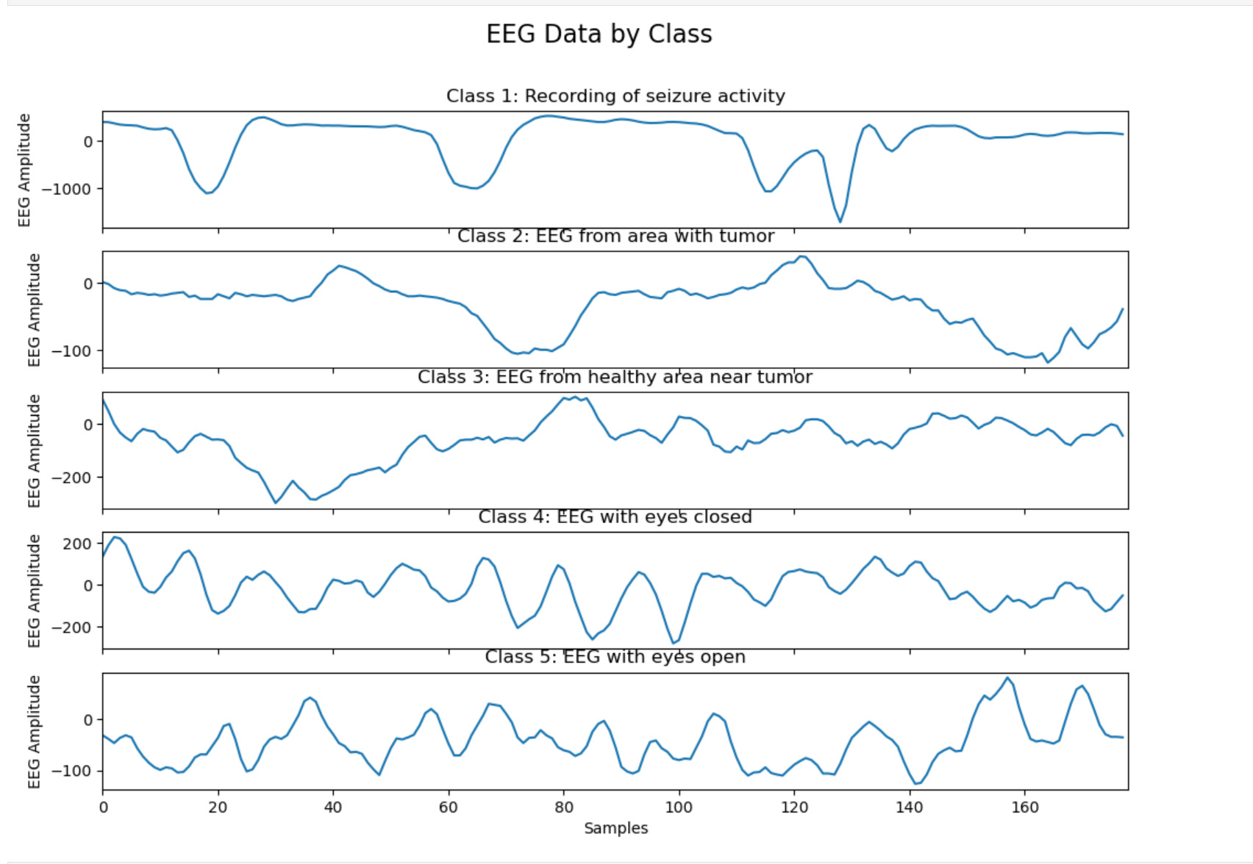
Initial Data Exploration cont.
When plotting the EEG recordings for the 5 target classes (before conversion into binary classes) (Figure 1):
Class 1 (seizure activity) shows distinct peaks and troughs in the EEG signal, indicating that specific EEG values could be important features for identifying seizure activity
All remaining classes (associated with non-seizure activity) do not exhibit as distinct peaks/troughs in their EEG signals
Classes 4 and 5, while showing rhythmic oscillations, don’t seem to align with seizure activity.
Figure 1: Each plot above shows EEG signals for each of the 5 classes (before the binary transformation of the target variable).

Slide 5
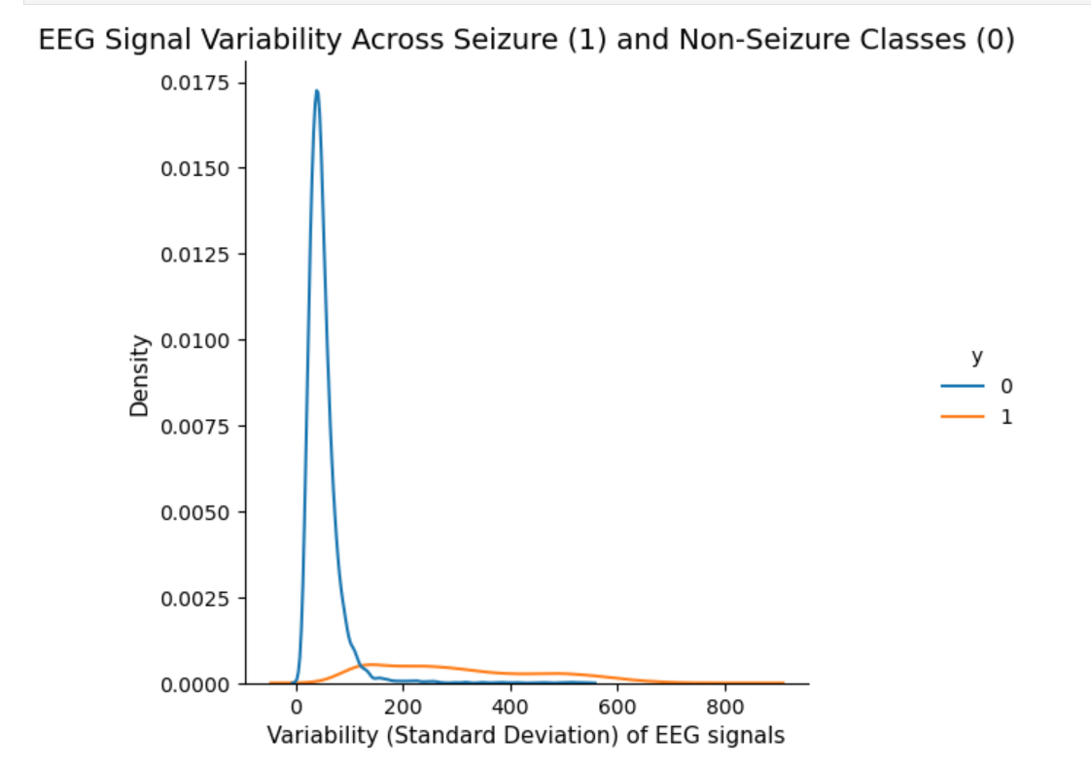
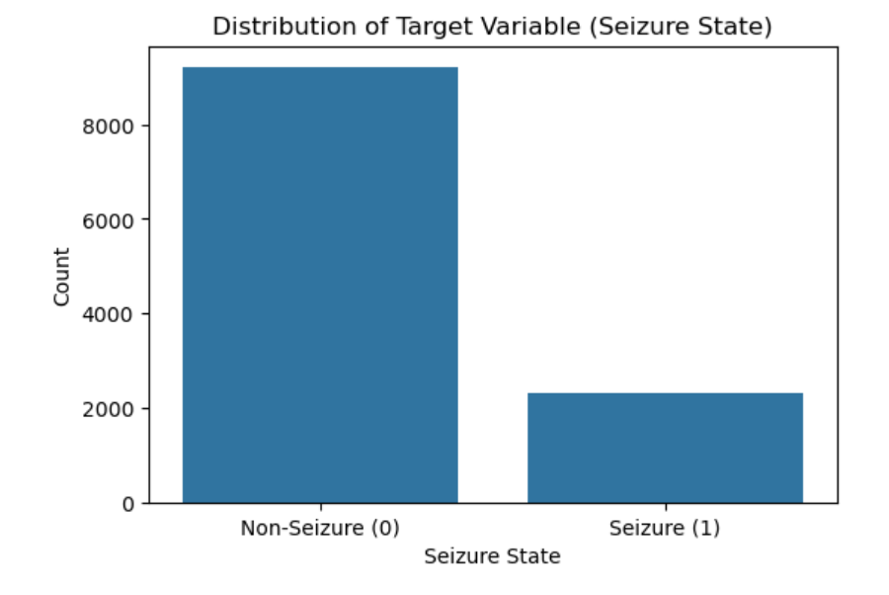
Cleaning and Sampling
There are no missing values in this dataset, so no missing data techniques are required.
EEG signal data varies substantially in magnitude between Seizure and Non-Seizure samples so data normalization will be required (Figure 1).
Since the data set only has mild imbalance (2,900 out of 11,500 - 20% minority class), imbalanced dataset techniques will not be required (Figure 2).
The dataset will be stratified split into 60% training, 20% validation and 20% test datasets to ensure that each dataset will accurately represent the class distribution.
Figure 1: The non-epileptic class peaks closer to 0, showing that the non-epileptic samples have lower variability. While the epileptic class has a broader distribution with lower density, showing that epileptic samples have more variability. This also showcases the irregularity of seizure activity.
Figure 2: The epileptic samples constitute the majority of the dataset, showing an approximate 80-20% distribution of the majority and minority classes.

Slide 6
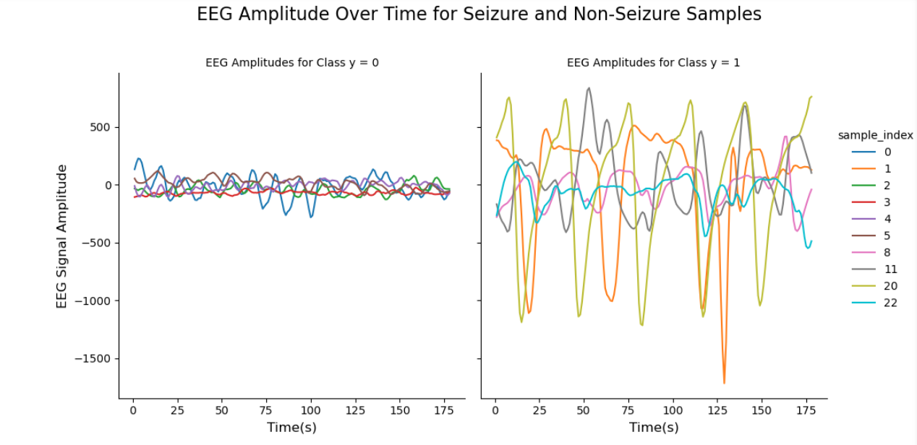
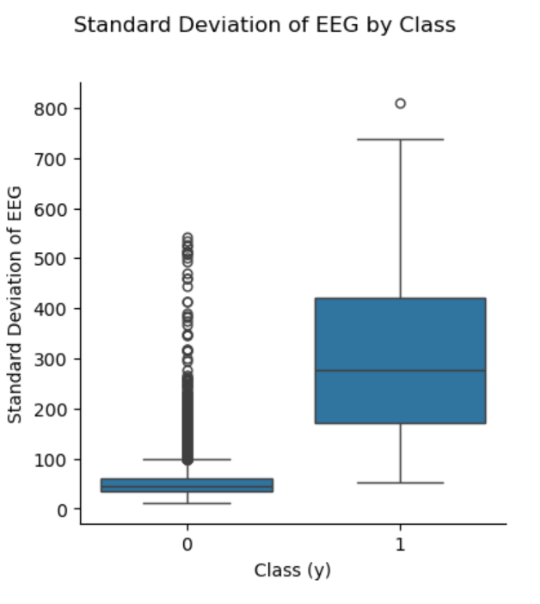
Data Exploration Insights
The plot below shows clear differences between the amplitudes of EEG signals for 5 samples of each category during a Non-Seizure (left of Figures 1 and 2) and a Seizure recording event (right of Figures 1 and 2). These differences can be leveraged in the ML classification algorithms we employ by potentially utilizing signal amplitude characteristics (ex: standard deviation) as a feature in the model.
Figure 1: The non-epileptic amplitudes (left) have significantly less fluctuation than the epileptic seizures on the right. This is expected as seizure activity is associated with more irregular/fluctuating brain signal activity. The seizure samples also exhibit distinct peaks at specific time points, which may correspond to moments when seizures have occurred. The EEG values at these peaks will likely have high feature importance in the final ML model.
Figure 2: The width of the boxplot for the non-seizure distribution is much narrower, clearly showing the significant difference in variability between both seizure and non-seizures.

Slide 7
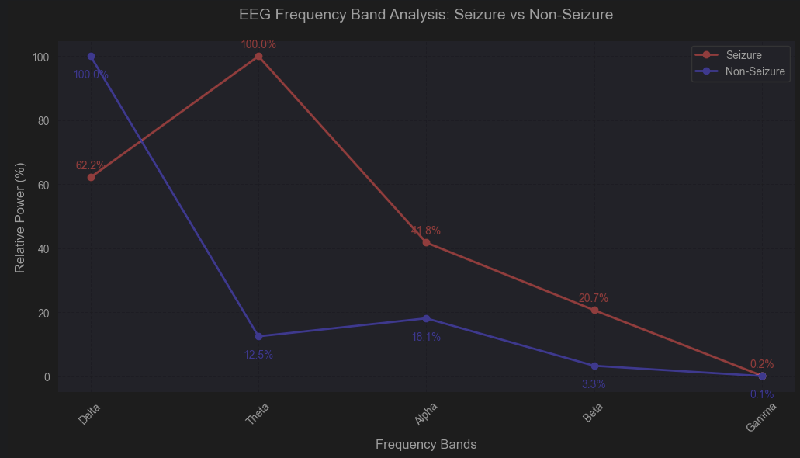
Data Exploration Insights
Delta Band:
T-statistic: 5.80
Absolute difference: 37.84%
Theta Band:
T-statistic: 7.44
Absolute difference: 87.53%
Alpha Band:
T-statistic: 7.82
Absolute difference: 23.67%
Beta Band:
T-statistic: 6.00
Absolute difference: 17.39%
Gamma Band:
T-statistic: 5.56
Absolute difference: 0.12%
The plot below (Figure 1) shows frequency band analysis of EEG signals, breaking down brain activity into different frequency ranges (Delta: 0-4 Hz, Theta: 4-8 Hz, Alpha: 8-13 Hz, Beta: 13-30 Hz, and Gamma: >30 Hz), where each band represents distinct types of brain activity, allowing us to analyze how the distribution of these frequencies differs between seizure and non-seizure states.
Figure 1: Comparison of power distribution across EEG frequency bands between seizure and non-seizure states, showing the normalized power (%) for each frequency band. The analysis reveals distinctive patterns in frequency distribution, particularly in the Theta Band which could serve as discriminative features for seizure detection.

Slide 8
Machine Learning Algorithms
XGBoost – An optimized gradient boosting machine learning algorithm designed for speed and performance, often used for classification and regression tasks.
TabNet - A deep learning algorithm designed for tabular data that uses sequential attention to select features at each decision step, enabling interpretability and high performance on structured data tasks
Random Forest - An ensemble learning algorithm that constructs multiple decision trees during training and outputs the mode of their predictions for classification or the mean for regression tasks
1D-Convolutional Neural Network - A deep learning algorithm that applies convolutional operations to one-dimensional data, such as time series or sequences, to automatically learn and extract features for tasks like classification and regression.

Slide 9
Basic Evaluation metrics
Recall (Sensitivity): In seizure detection, failing to identify a seizure (low recall) can have more severe consequences than incorrectly identifying a non-seizure event as a seizure event (false positive). For instance, when using the standard deviation of 178 labels for objects as a single label in a simple Logistic Regression model, we achieved 95.7% accuracy but only 84% recall for class 1 (seizure detection), so it’s essential to improve and prioritize the recall.
Precision, Accuracy, and F1-Score: These are additional important metrics derived from the confusion matrix that should also be considered in model evaluation.
AUC-ROC Curve: To assess the model’s ability to distinguish between classes at various threshold levels, another important metric is AUROC. It helps us compare the robustness of different models.

